Slide 1


Team 20: 3-Phase Matrix Converter
Final Demo Chase Barnes, Daniel Loeza, Shanelle Algama Sponsor: Dr. John Lusher TA: Rhett Guthrie

Slide 2
Problem Overview
Our project addresses the inefficiencies found in traditional Variable Frequency Drives (VFDs) by designing a more efficient three-phase matrix converter. VFDs are crucial in controlling the speed of AC motors by adjusting the frequency of the AC input voltage, making them essential in various industries such as manufacturing, HVAC systems, and more. However, conventional VFDs employ an AC-DC-AC conversion process which introduces inefficiencies and increased part count. Our design implements direct AC-AC conversion, which removes the need of additional components, including electrolytic energy storage, and in turn increases efficiency of the output power.

Slide 3
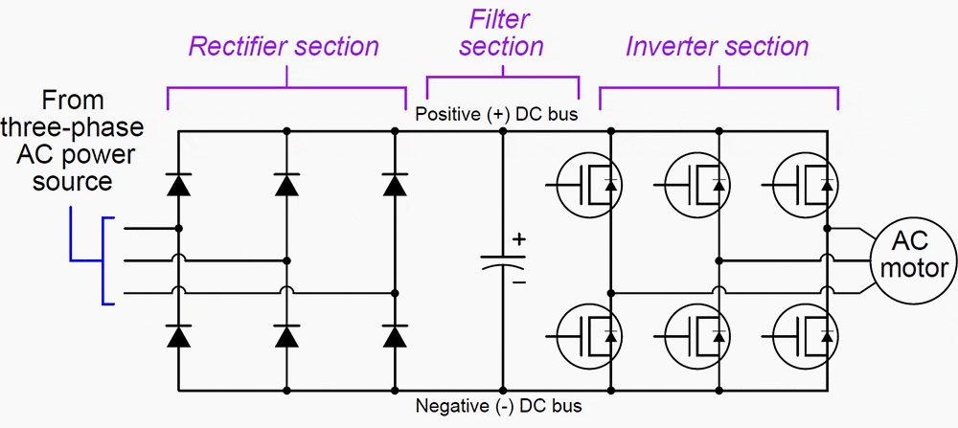
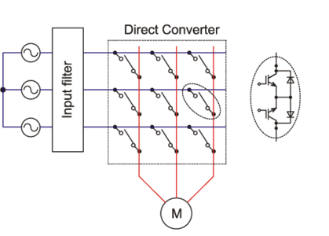
Project Summary
Traditional Variable Frequency Drives utilizes AC-DC-AC conversion:
Decreased efficiency across power output, and increased harmonic distortion.
3 Phase Matrix Converter utilizes AC-AC conversion:
Reduced efficiency loss across components.
Notes:
Barnes

Slide 4
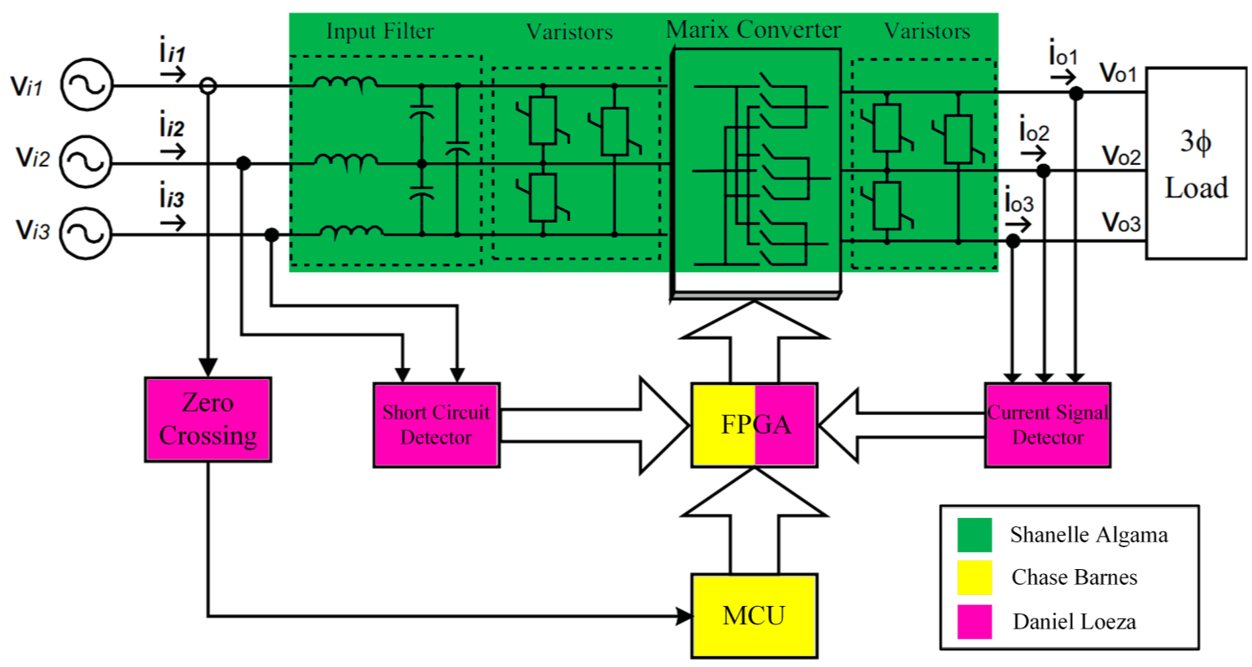
System Overview
Notes:
Shanelle

Slide 5
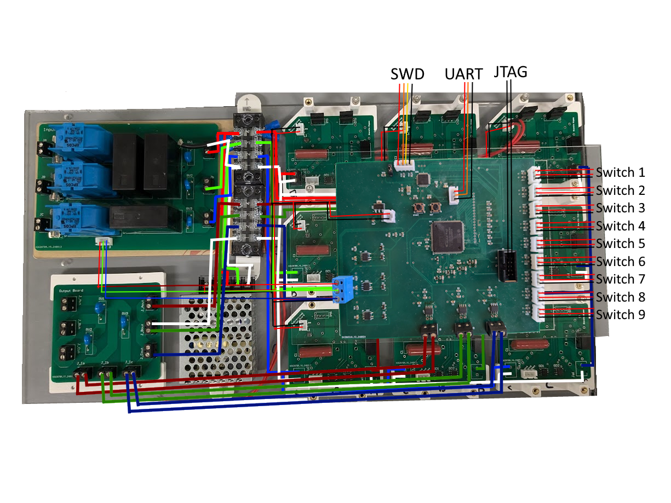
Integrated System Diagram
Notes:
TODO HAVE EVERYONE ELSE LOOK AT

Slide 6
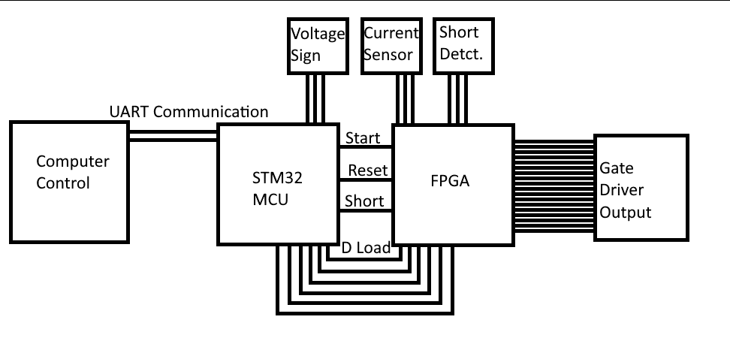
Firmware Subsystem
Used Algorithms for
Frequency Change
Safe Commutation
Frequency Change on Microcontroller
Commutation and
Shorting on FPGA

Slide 7
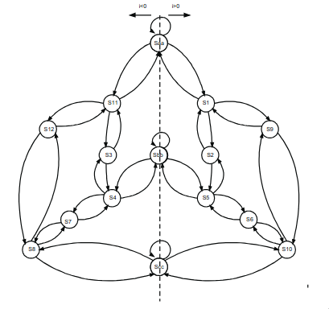
Firmware Subsystem
FPGA Commutation:
Finite State Machine for the Output Current change to allow the discrete IGBT to not short during input phase change

Slide 8
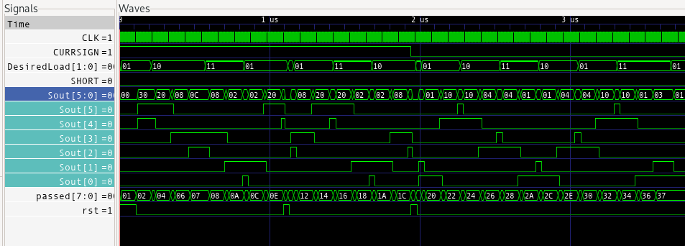
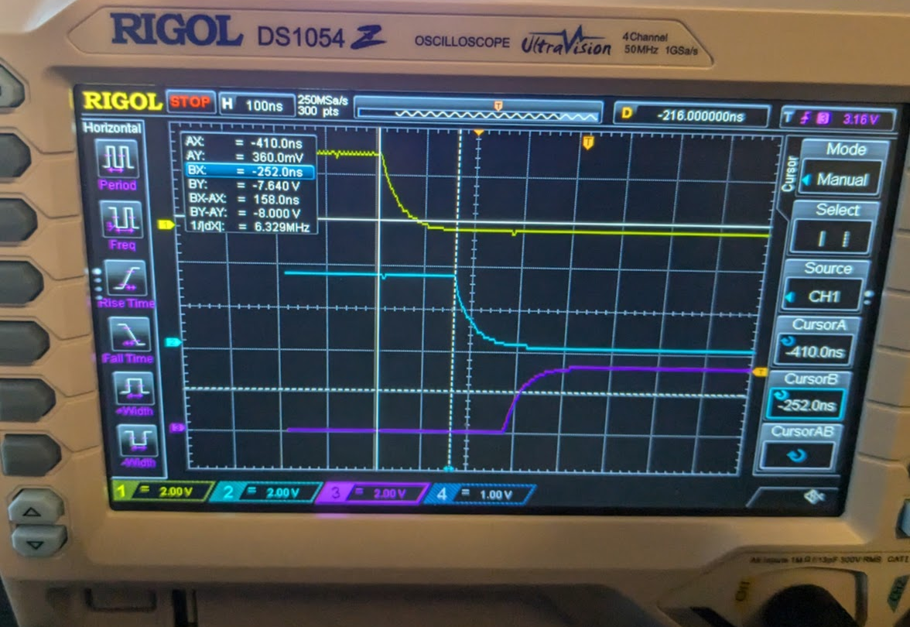
Firmware Subsystem
Simulated Commutation
Validated Commutation
Yellow represents A to a 1
Blue represents A to a 2
Purple represents B to a 1

Slide 9
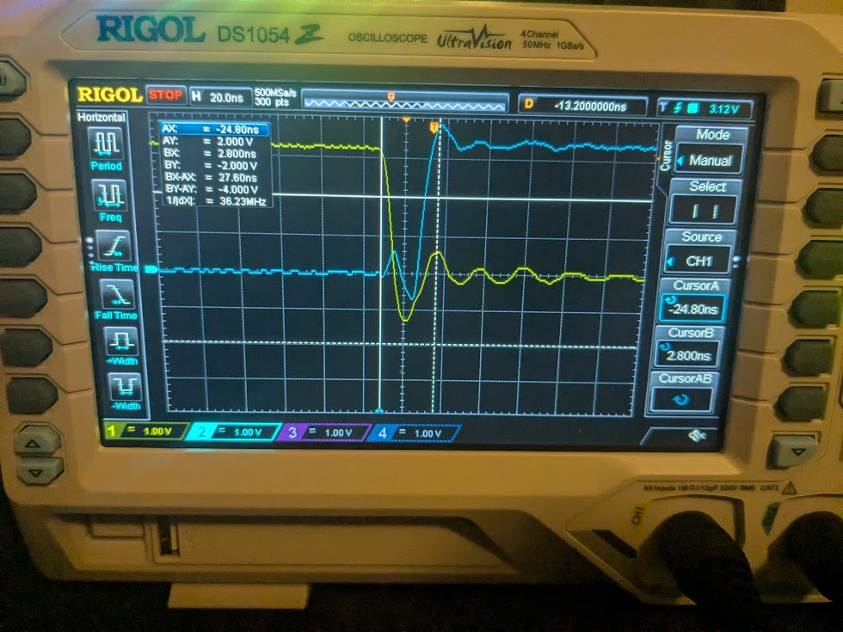
Firmware Subsystem
Simulated FPGA Short
FPGA Timing Req. | Requirements | FPGA Results
TDon | >19ns | 118ns
TDoff | >100ns | 158ns
Shorting | <6us | 28ns
Yellow Represent FAULT’
Blue Represents Short Pin

Slide 10
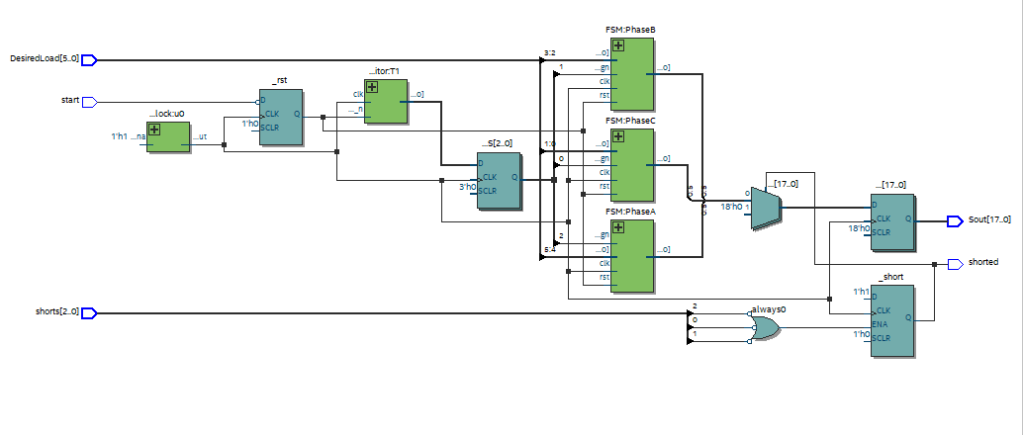
Firmware Subsystem
FPGA RTL View

Slide 11
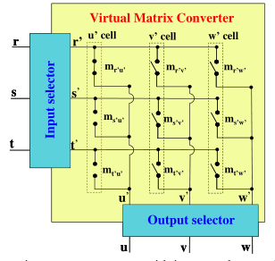
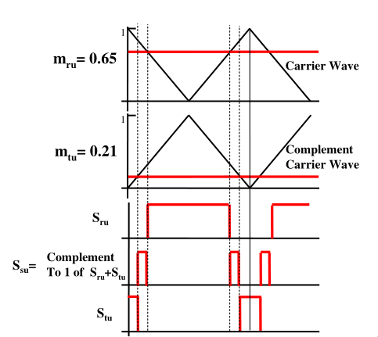
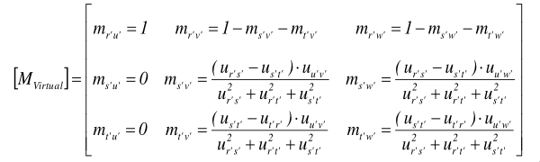
Firmware Subsystem
Microcontroller Space Vector Modulation

Slide 12
Firmware Subsystem
Microcontroller Uart Communication

Slide 13
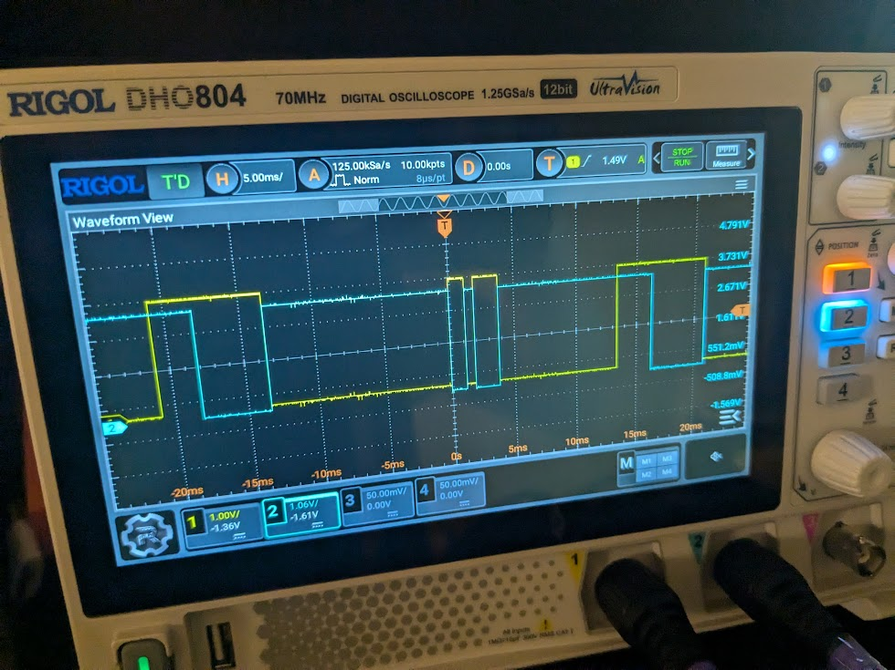
Firmware Subsystem
Microcontroller Communication to FPGA
2 Pin Bus with Phase Information to FPGA

Slide 14
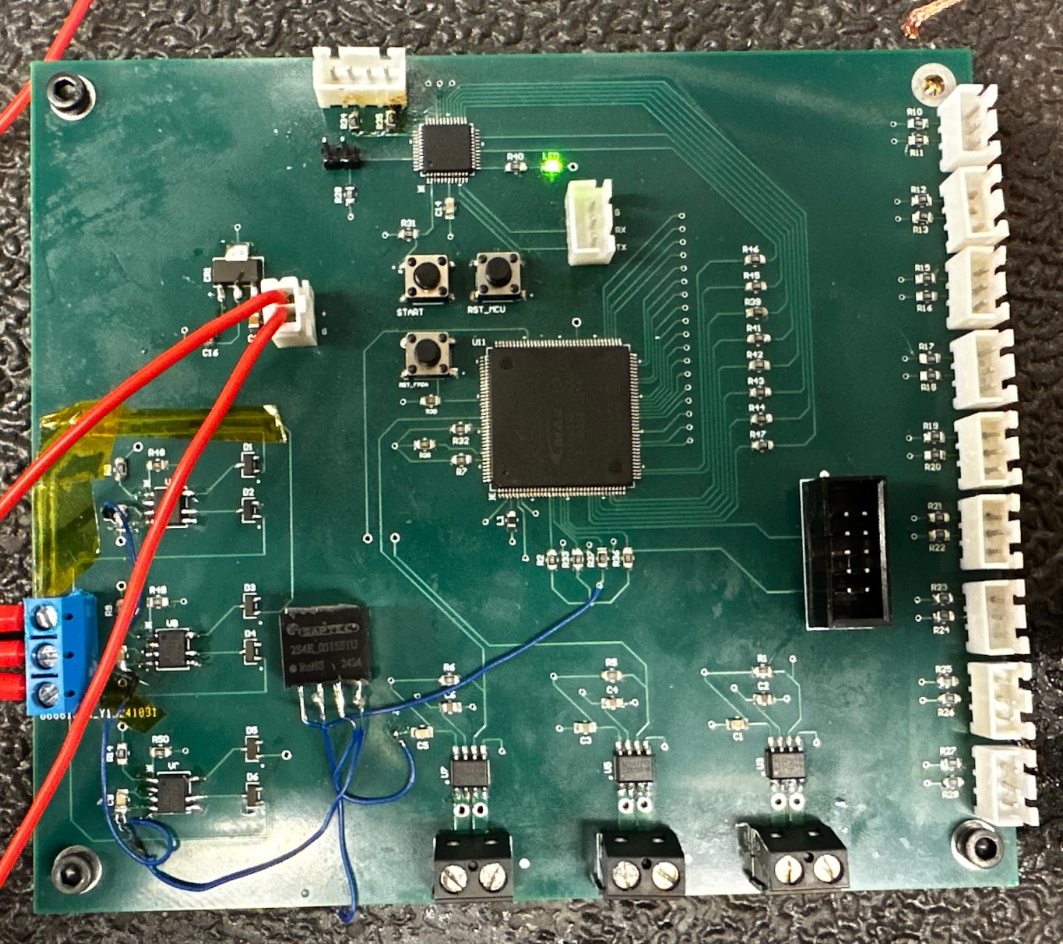
Pulse Generator Subsystem
This system holds the FPGA and MCU, which control the frequency of the output and handles the safe commutation of the matrix converter.
5 Volt DC input to a voltage regulator that outputs 3.3 Volts. This 3.3 Volt output powers the components on the board.
FPGA outputs to the bidirectional switch inputs. Switches are then turned ‘on’ or ‘off’ based on the phase of the filtered input AC voltage.

Slide 15
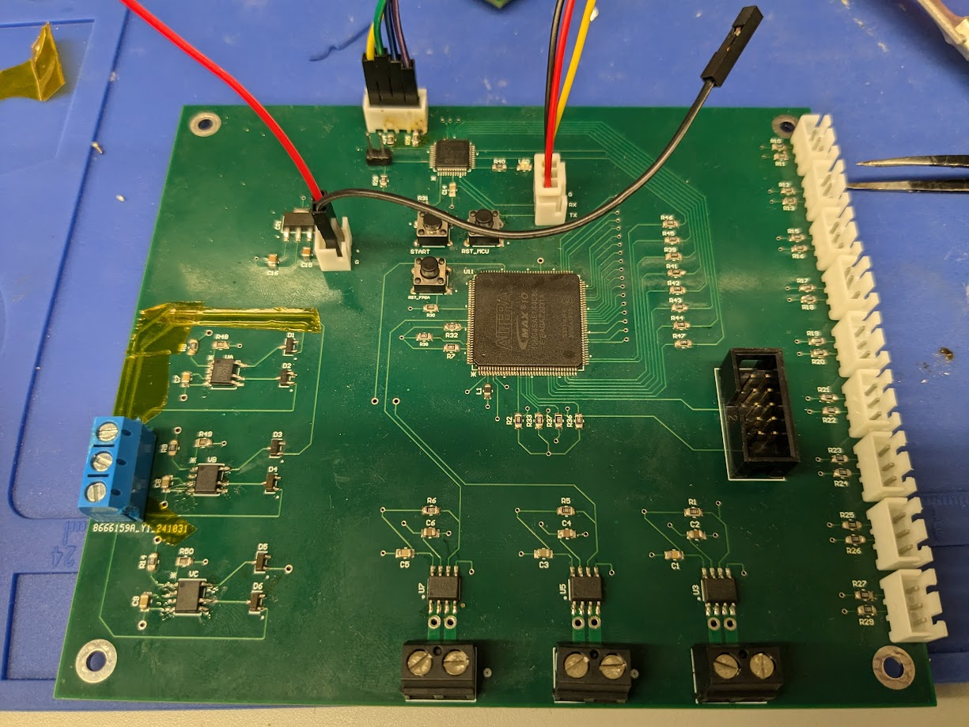
Pulse Generator Subsystem
MCU Flashing
MCU
UART Communication
Voltage Regulator Input
FPGA Output to Matrix Converter
FPGA
FPGA Flashing
Zero Crossing Section
Current Sensor Section

Slide 16
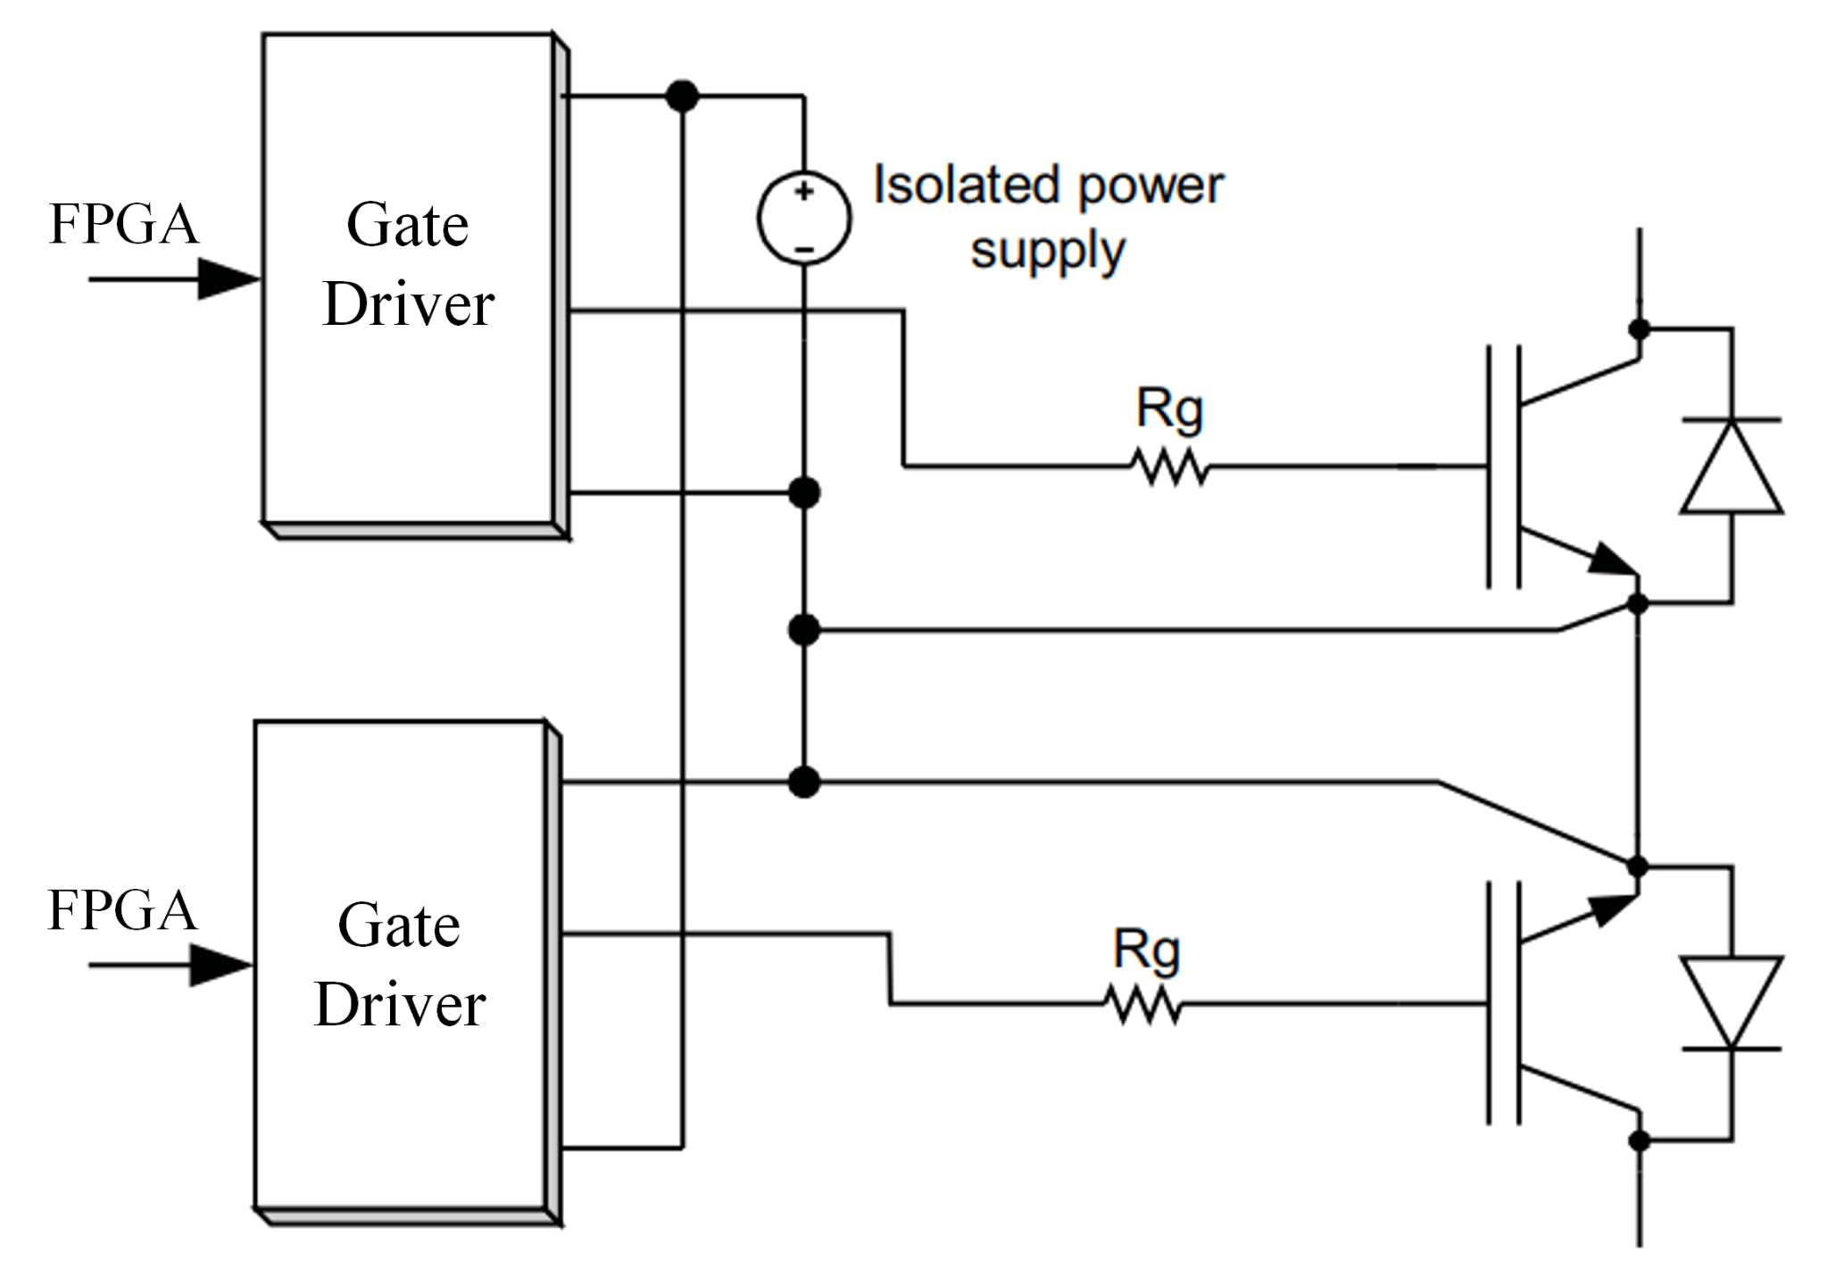
Matrix Converter Subsystem
This is the power electronics system designed to perform direct AC-AC conversion without an intermediate DC link.
The source three-phase AC power connects to an input LC filter board which includes varistors for overvoltage protection.
Utilizes a 3x3 matrix of bidirectional switches which comprises of two IGBT transistors and two gate drivers.
3 Phase Total: 18 IGBTs and 18 gate drivers
Includes three more varistors on the output phases (Output Filter Board)
Bidirectional Switch with Common Emitter Configuration
Notes:
Shanelle

Slide 17
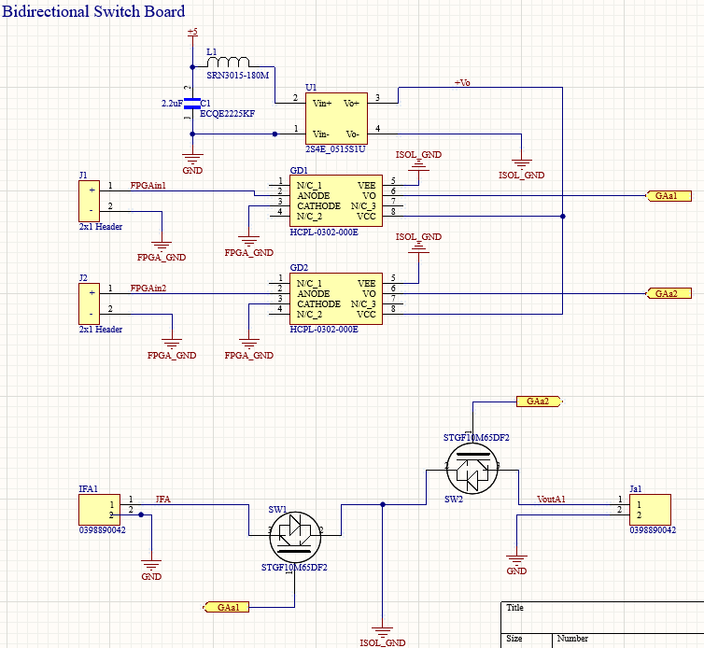
Matrix Converter Subsystem
Bidirectional Switch Schematic with common collector configuration
Currently updated with common emitter configuration

Slide 18
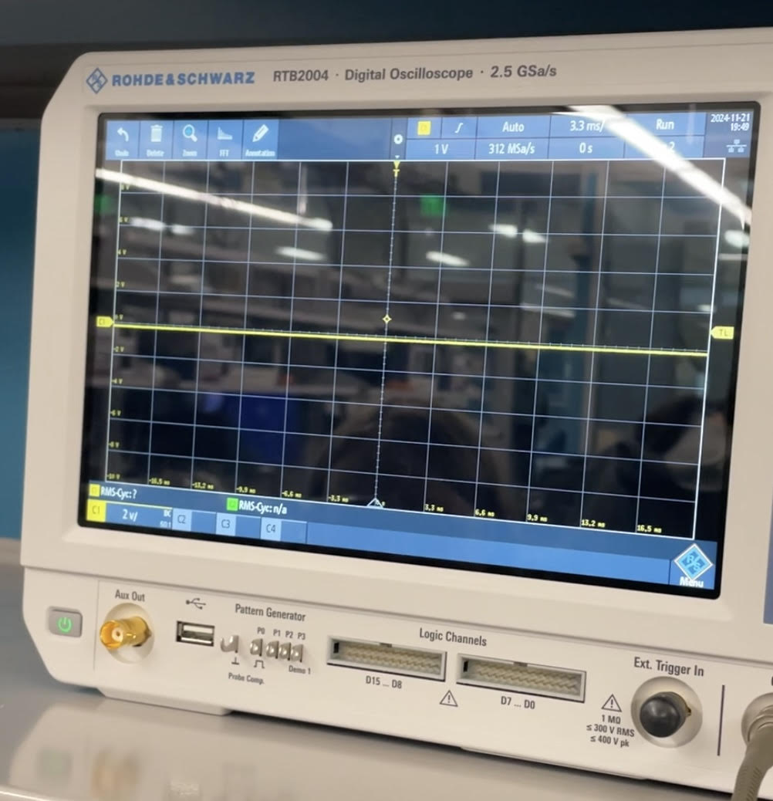
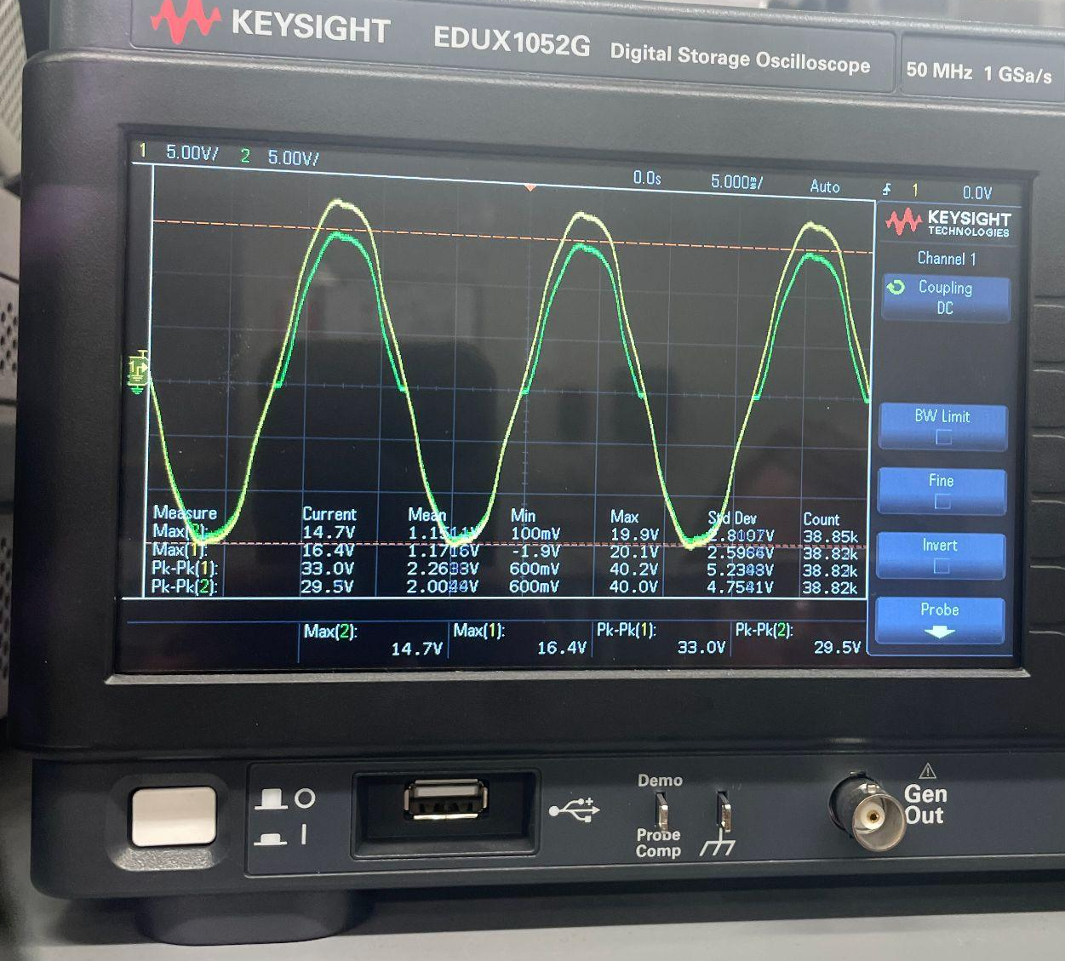
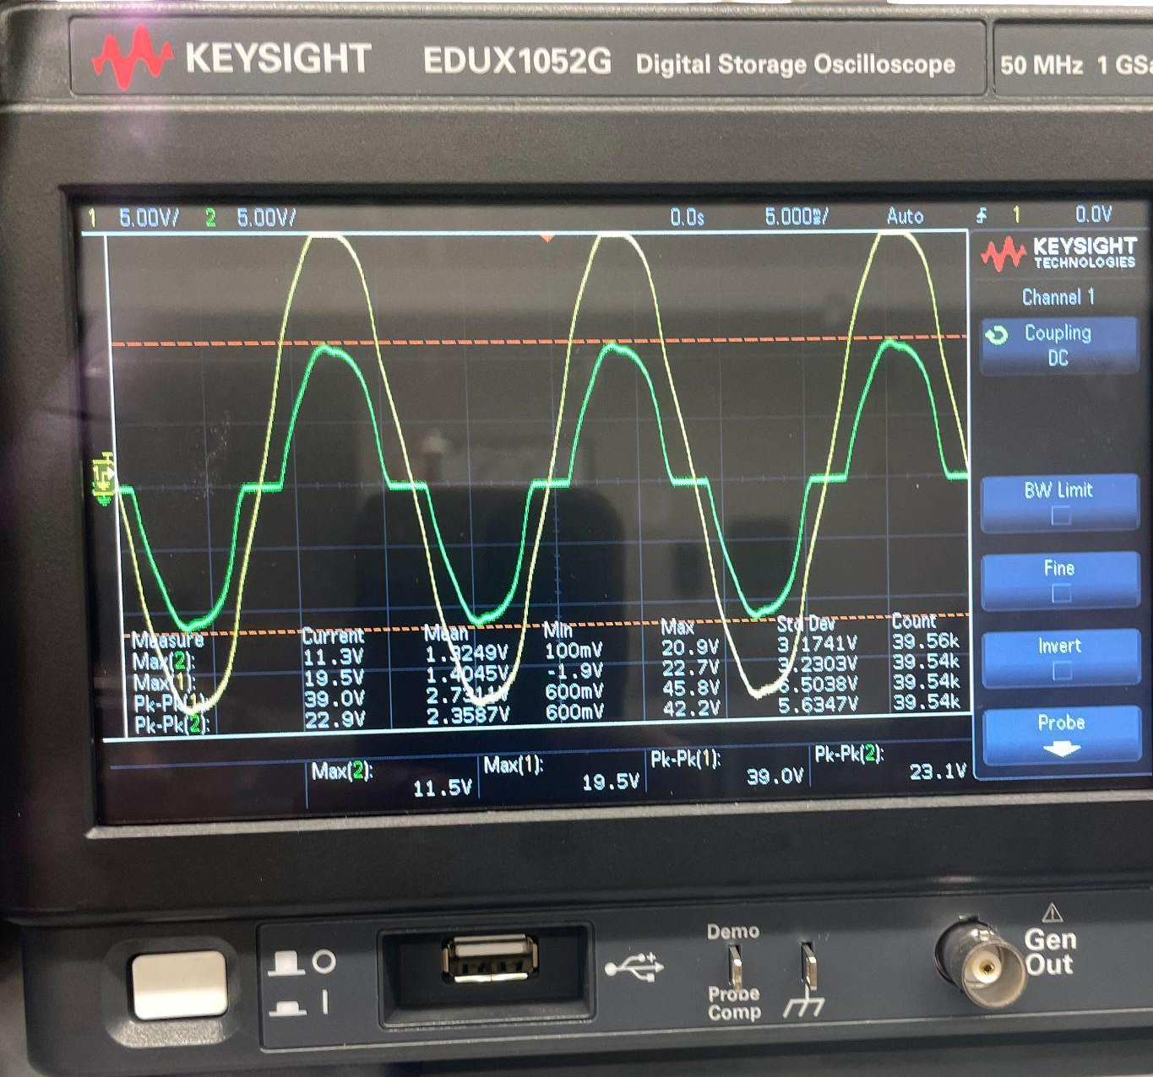
Matrix Converter Subsystem
Validated Functional Bidirectional Switch when both gate drivers are off and either gate driver or both gate drivers are on. One phase validated.
Gate drivers off (voltage blocking): Either or both gate drivers on:
(In isolation, up to 40Vpp)

Slide 19
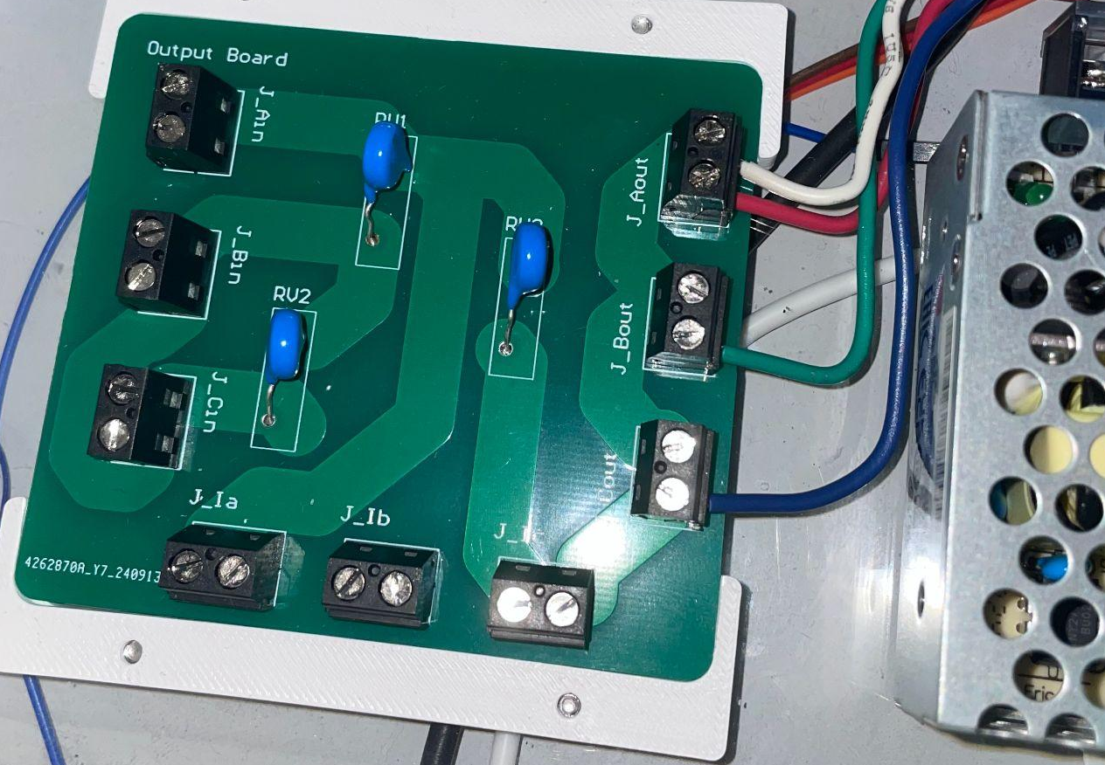
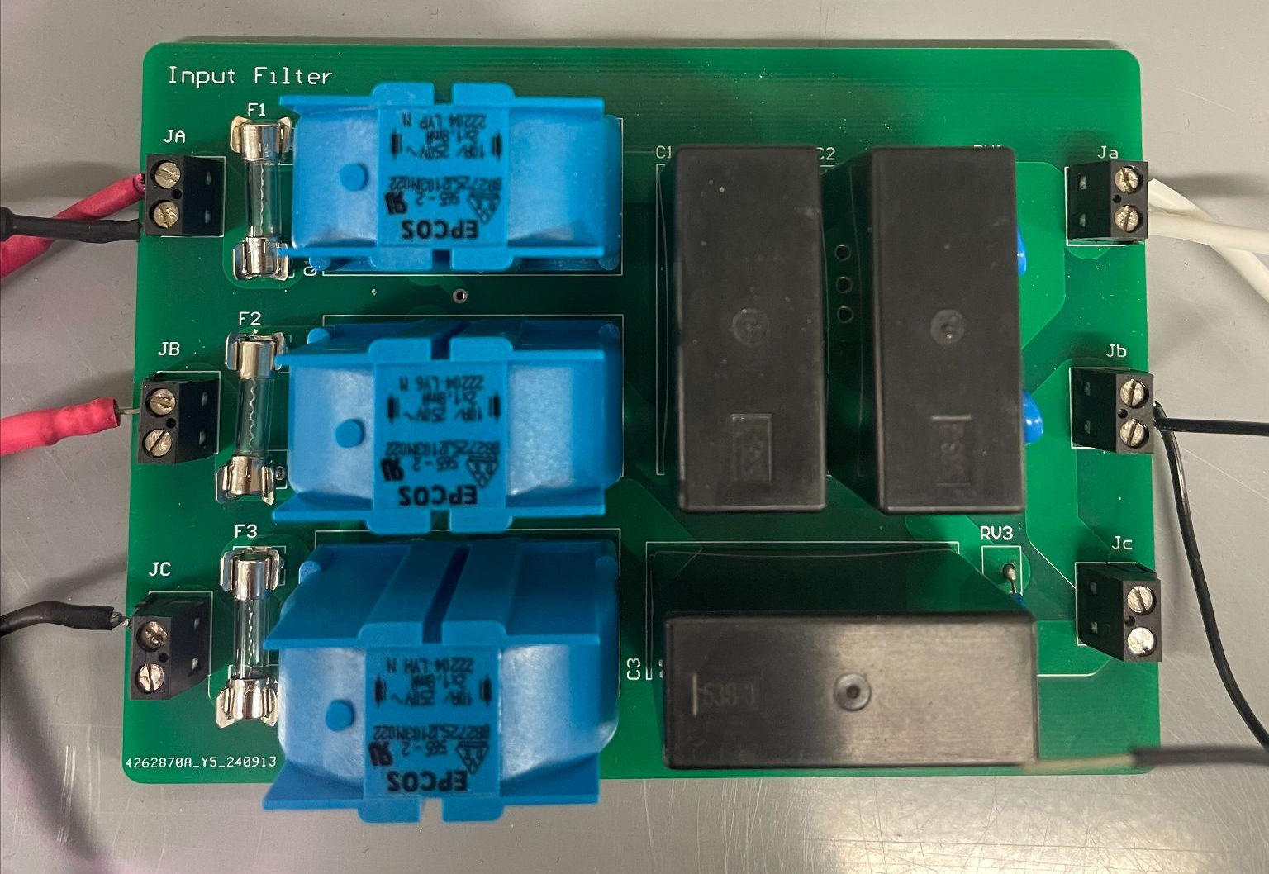
Matrix Converter Subsystem
Validated Input Filter and Output Filter Boards 120Vrms

Slide 20
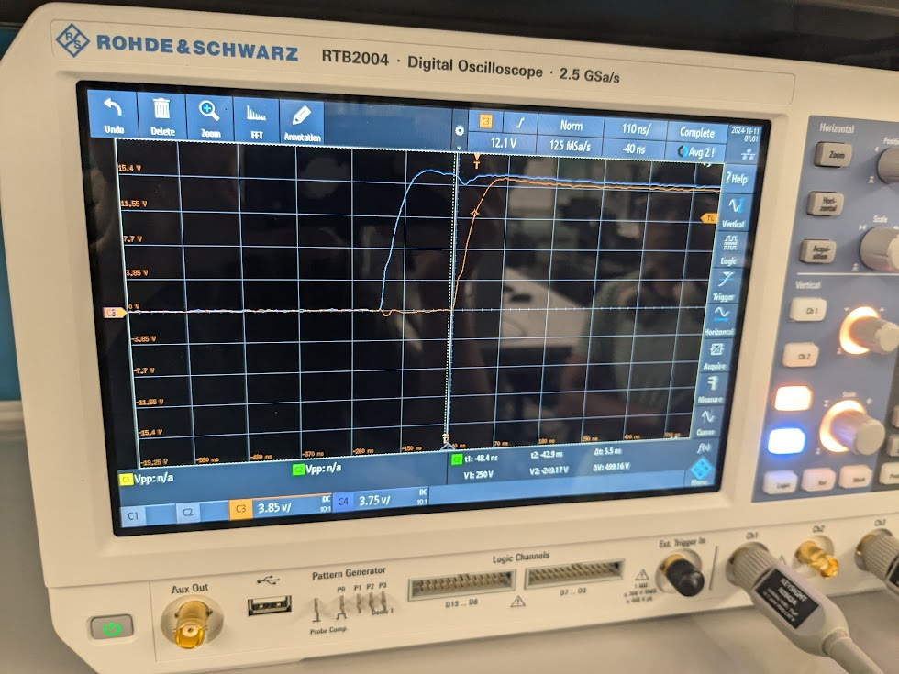
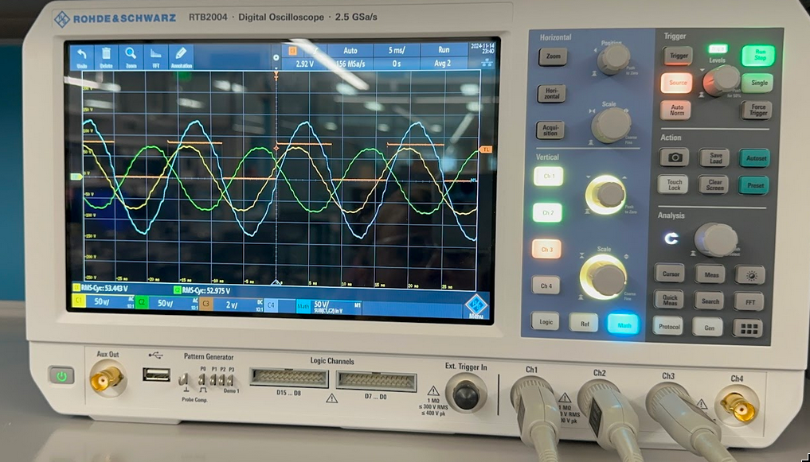
Validation
FPGA Powering Gate Drivers With Appropriate Timing
3 Phase Zero Crossing Sensor Functioning
Gate Driver | Requirements | Gate Driver
Td rise | 50ns | 54ns
TD on | >19ns | 126ns
TD off | <200ns | 162ns
Voltage Rise | >12V | 15.5 Volts

Slide 21
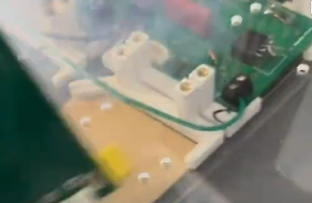
Issues We Came Across
Yesterday while attempting to validate turning the gate drivers on, we connected an oscilloscope probe to the ground on the pulse generator, and blew up a DC DC converter. This has ruined a power supply, voltage regulator, microcontroller, additional DC DC Converters, and much more. We have been unable to recover from this, and will be unable to properly demonstrate the device in action

Slide 22
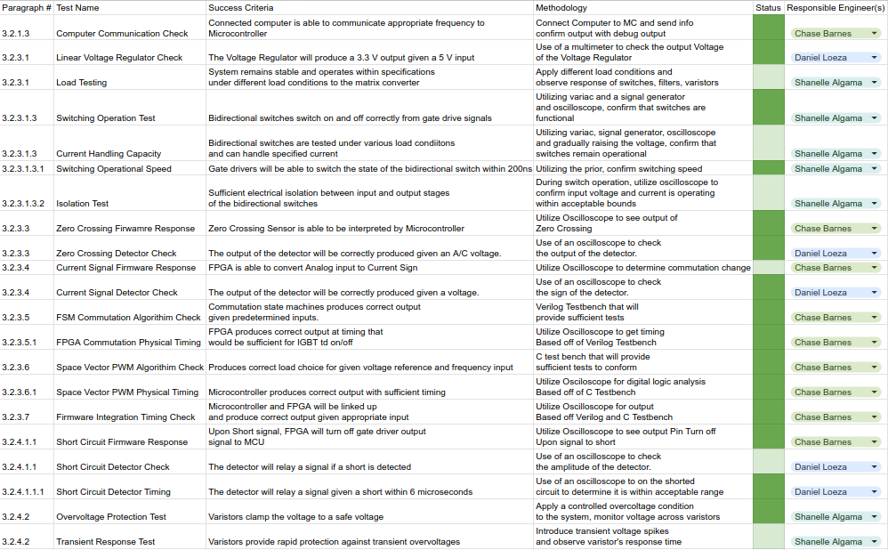
Validations Done
FPGA RTL View

Slide 23
Thanks, and Gig ‘em!

